Slide 1

Synchrony
Jacob Alspaw, Alex Hemm, Owen Helmstetter, Ted Timbrell, Bobby Wagner

Slide 2
What is it?
Synchrony (noun)
syn·chro·ny
state in which things happen, move, or exist at the same time
synchronized streaming service aiming to make the music listening experience social again by enabling users to choose songs to listen to and talk about together

Slide 3
Motivation
Radio was/is a social experience
Collaborative listening missing from key services
Use cases not covered by existing products
Listen as a group in public (without being rude)
People spend more money on headphones than speakers
Phone speakers are pretty bad
Connect and share with friends and family over long distances
Synchronization of speakers in different rooms

Slide 4
Features

Slide 5
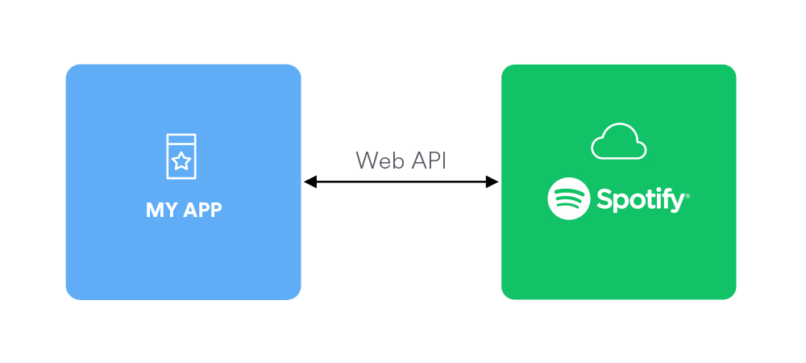
Core Features
Lobbies
Guest create and host lobbies
Join lobbies with lobby ID
Streaming
Delivers synchronized audio
Uses spotify API as source audio
Real Time Communications
Text chat
Notes:
Alex

Slide 6
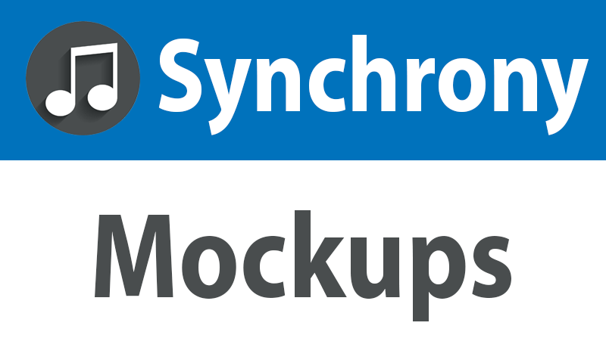

Slide 7
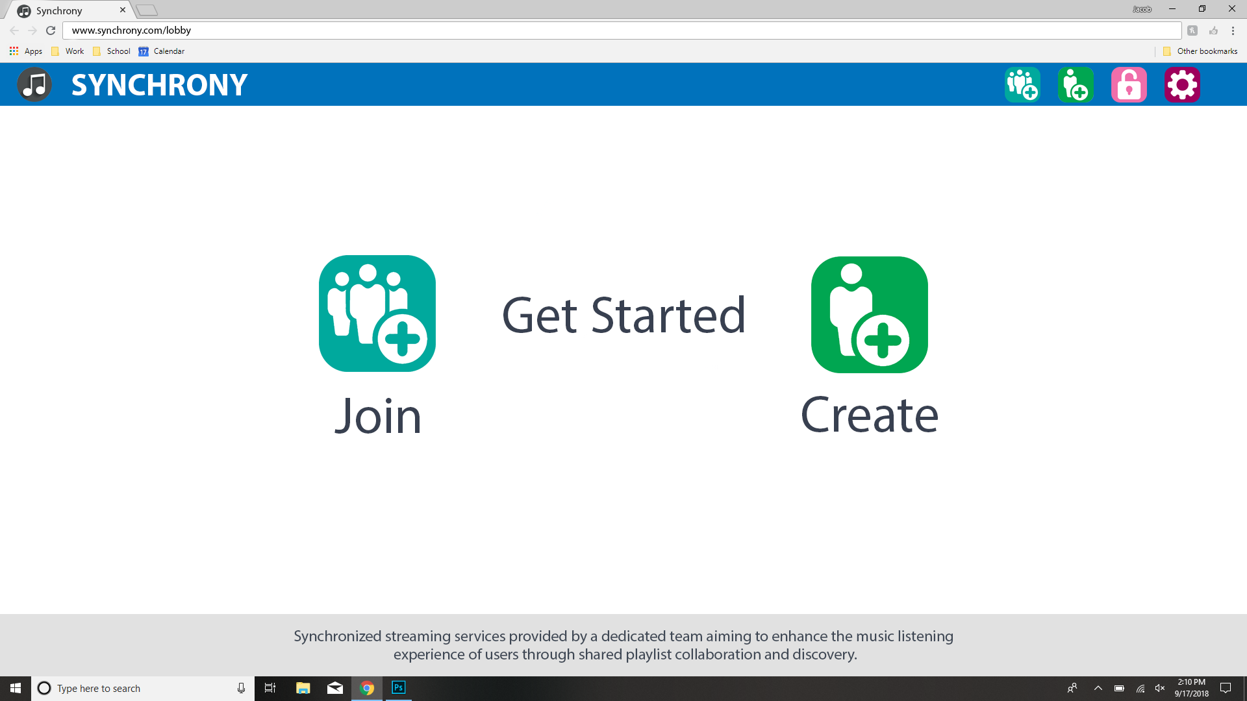

Slide 8
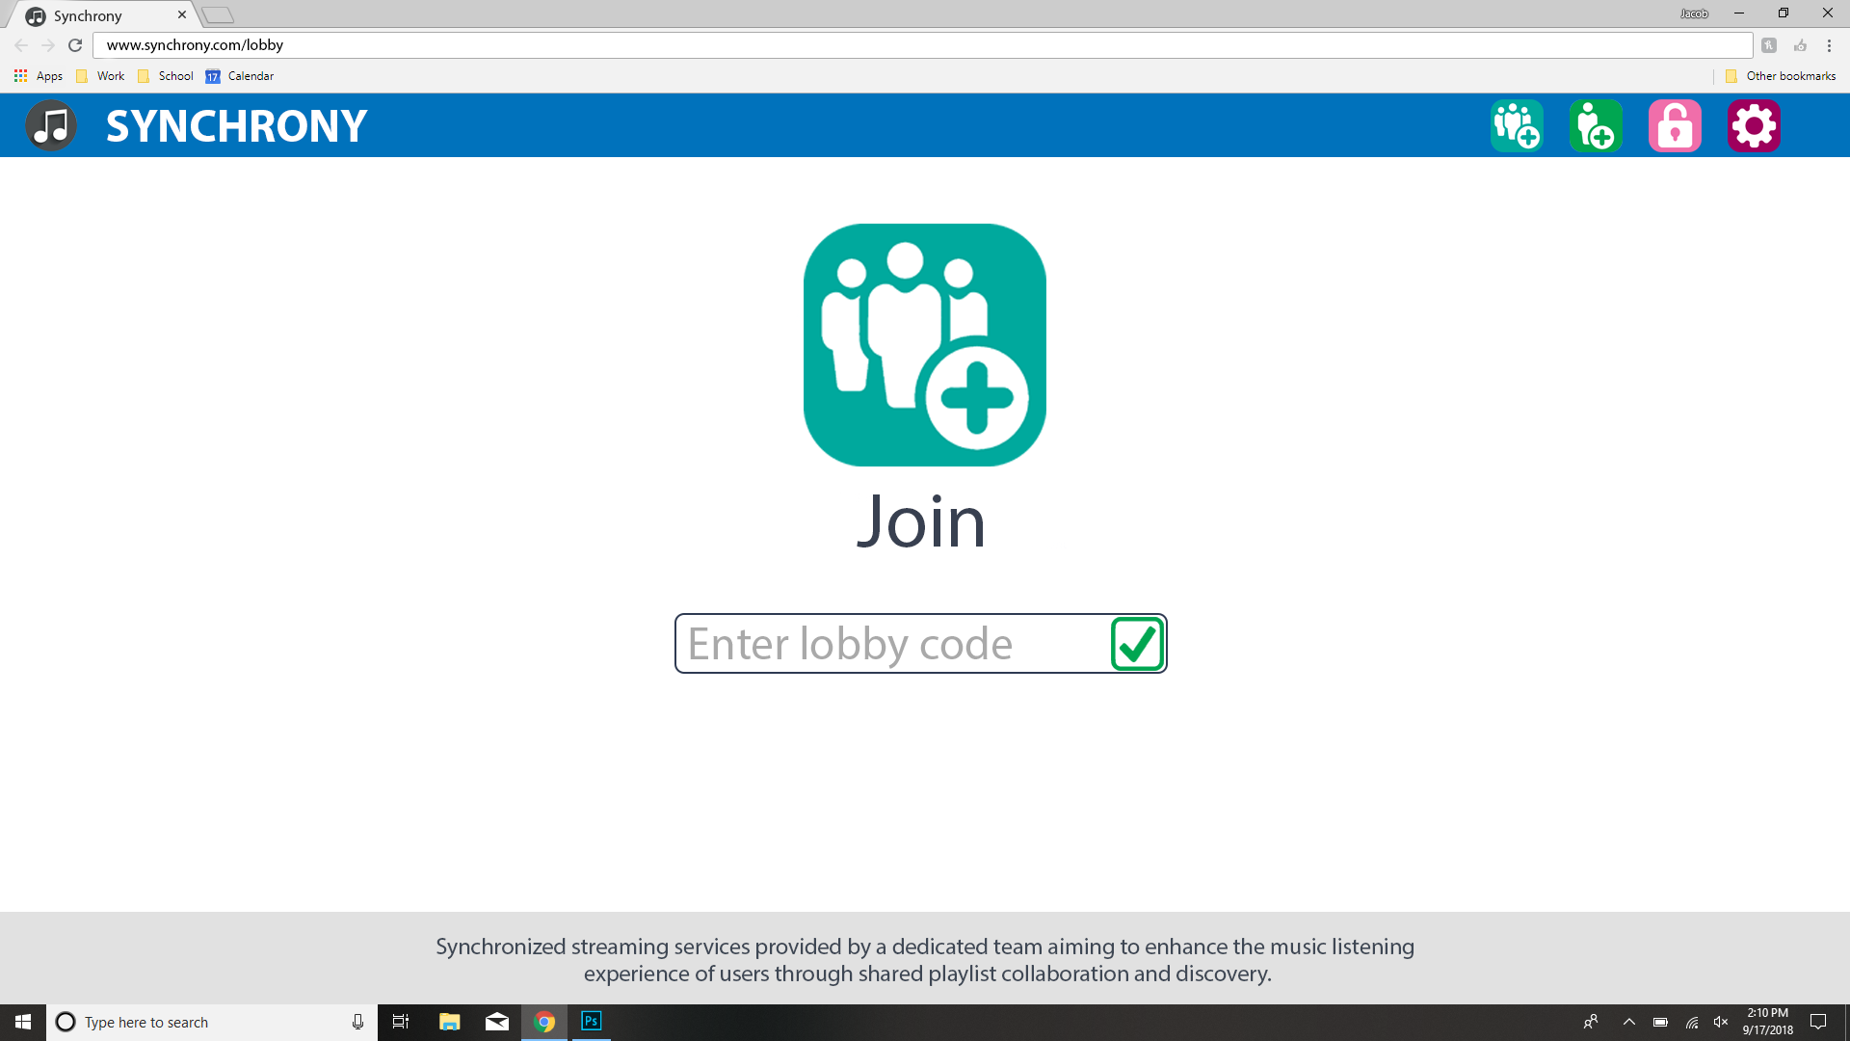

Slide 9
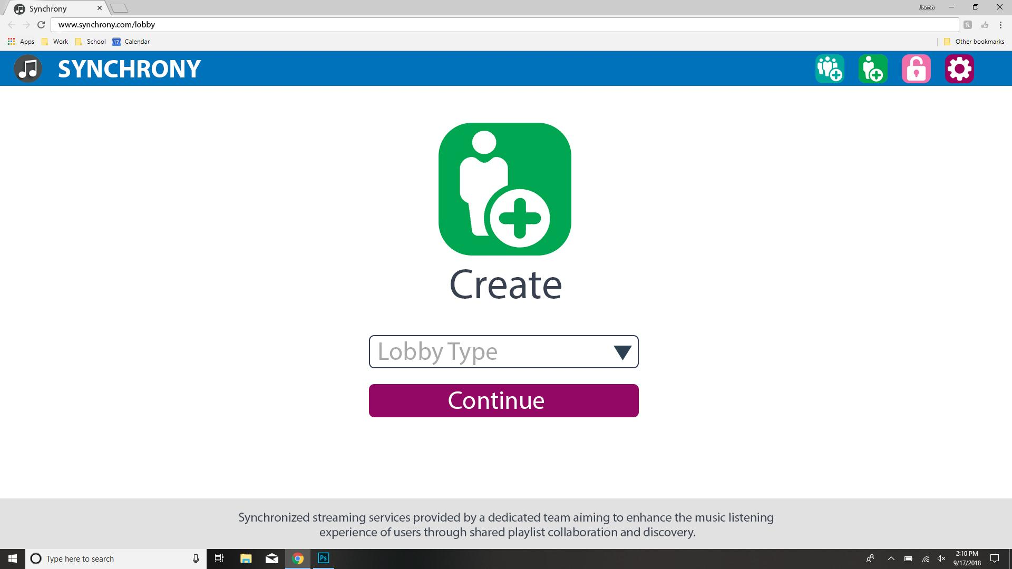

Slide 10
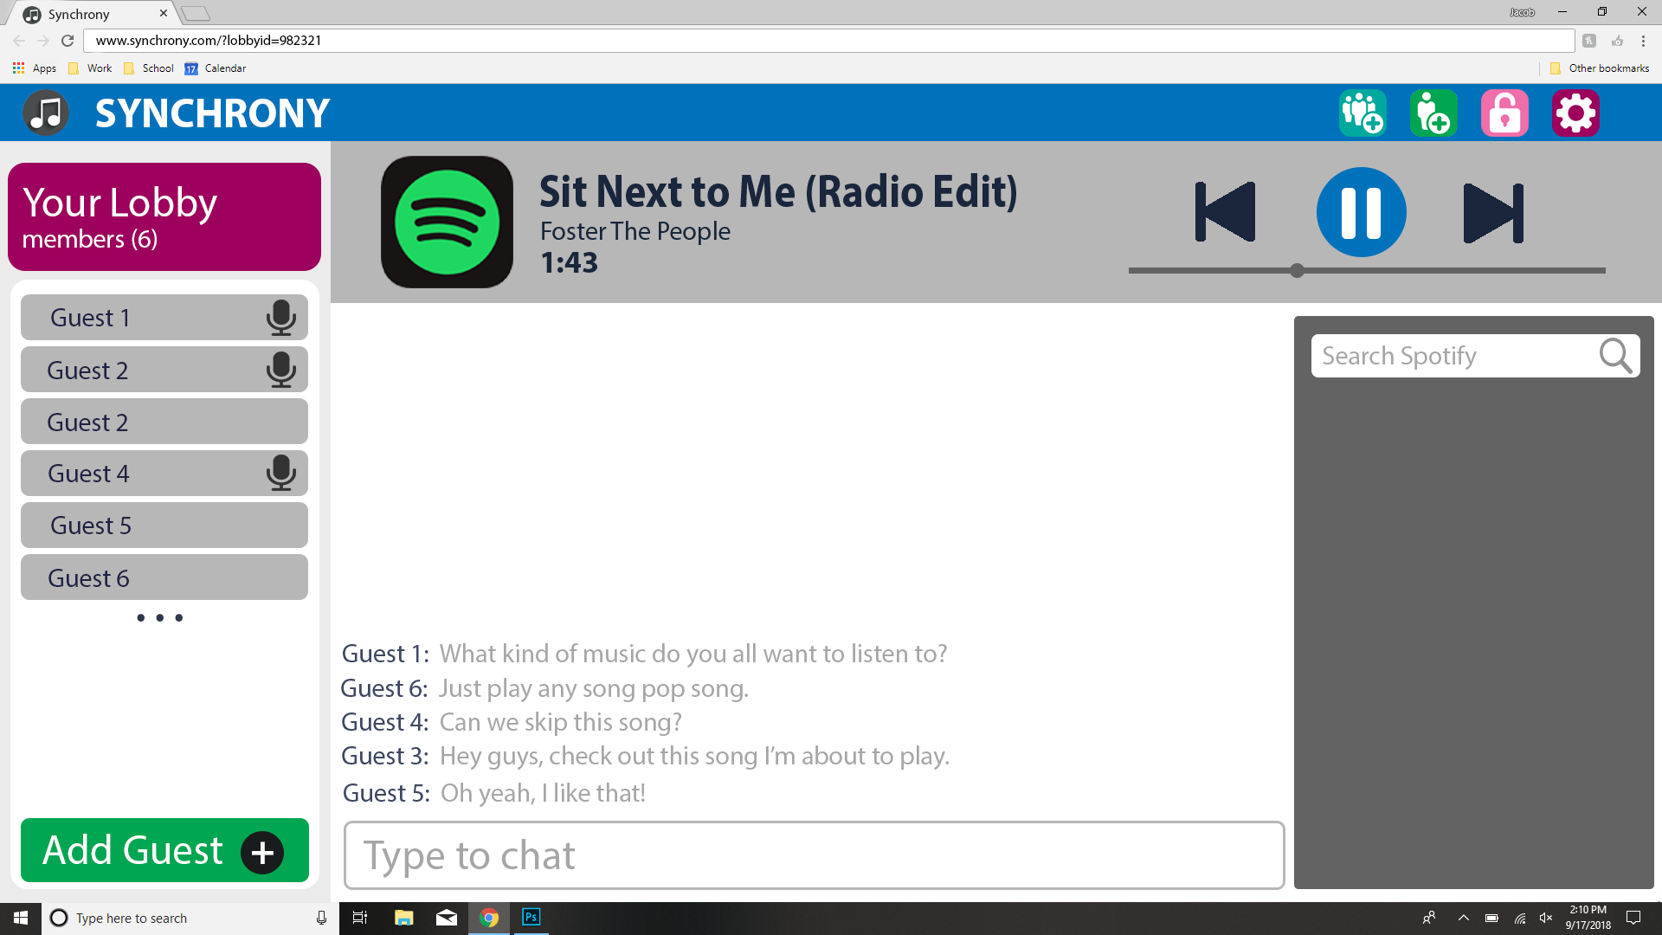

Slide 11
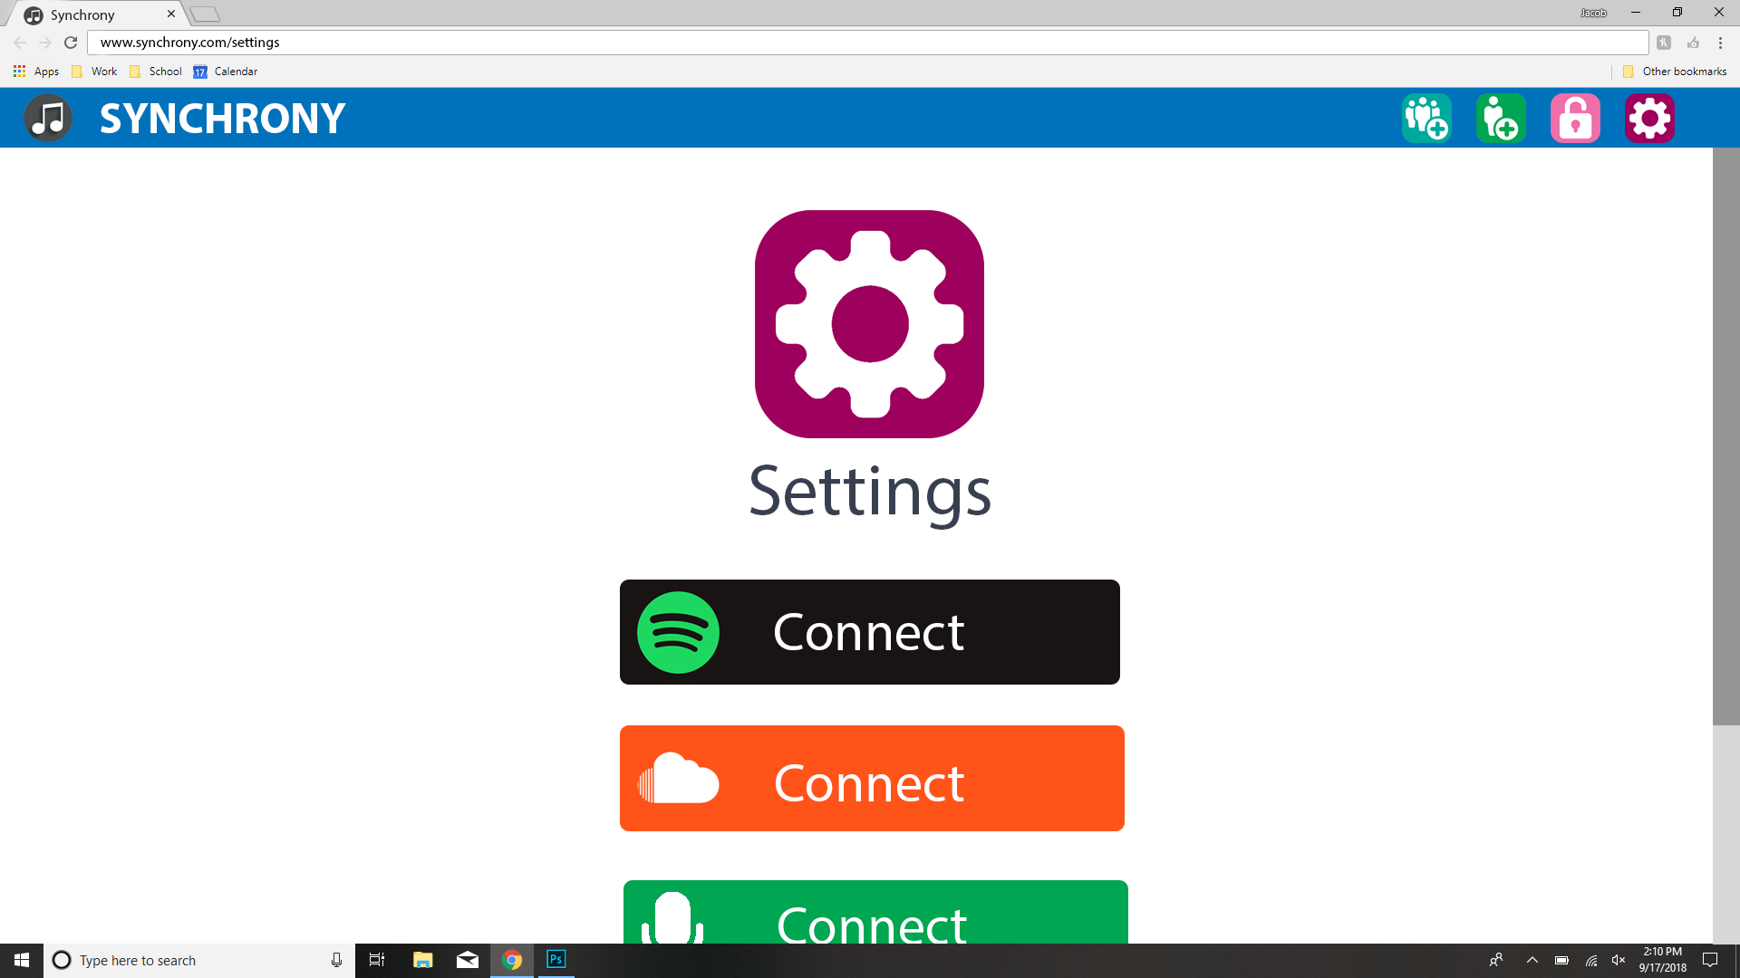

Slide 12
High Level Design

Slide 13
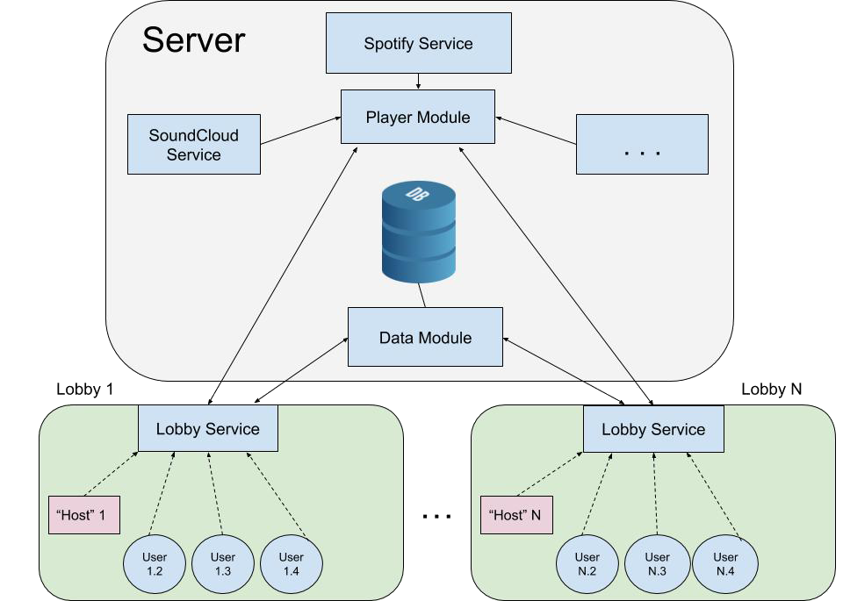
Architecture
Client-server model
Hosts and guests
Extensibility and loose coupling
Notes:
Bobby
https://en.wikipedia.org/wiki/Extensibility

Slide 14
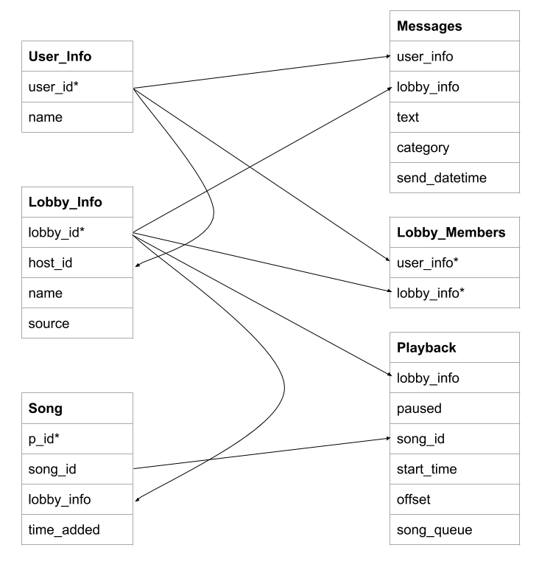
Database Design
PostgreSQL
Object relational design
Notes:
Bobby

Slide 15
Languages, Testing and Documentation
Notes:
owen

Slide 16



Languages and Tooling
Back-end
Django
PostgreSQL
Front-end
Angular 6

Slide 17
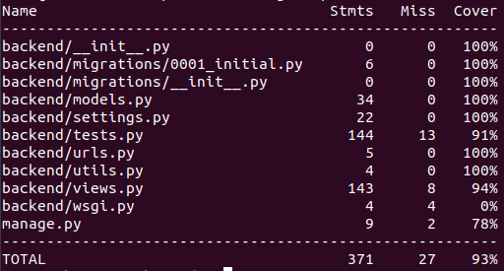

Testing
Django (Back-end)
Unittest
Coverage.py
Have 93% coverage for backend code
Angular (Front-end)
Jasmine test framework
Karma test runner
--code-coverage
Notes:
Using the Angular CLI for testing means that any time a change to the code is saved our tests will automatically start to run in the background.

Slide 18

Documentation
Admindocs (Django)
Backend comments are written with docstrings in the code
Compiled to a webpage
Compodoc (Angular)
Reads JSDoc style comments in the code
Creates Angular-specific documentation as a web page

Slide 19
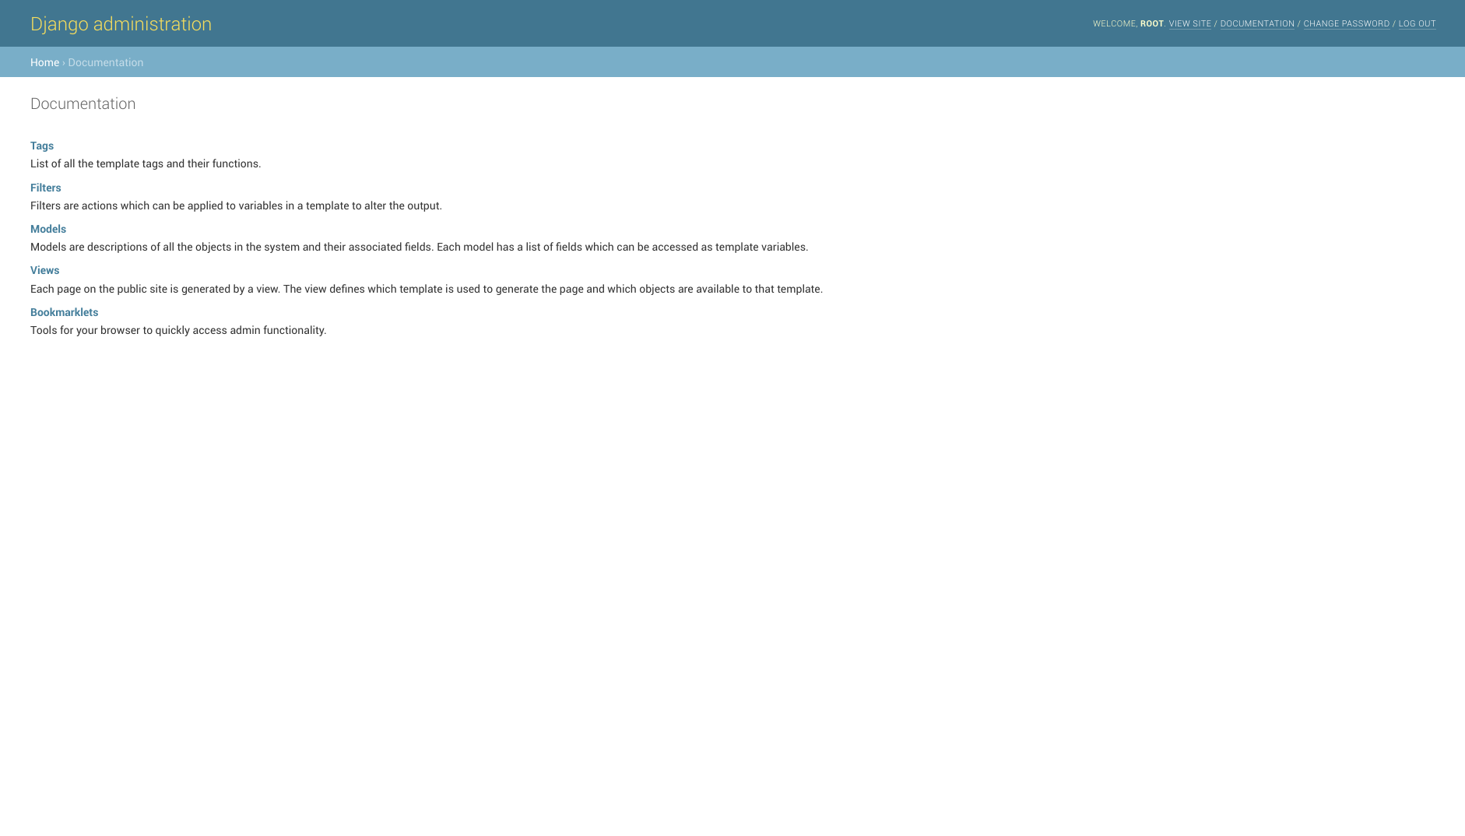

Slide 20
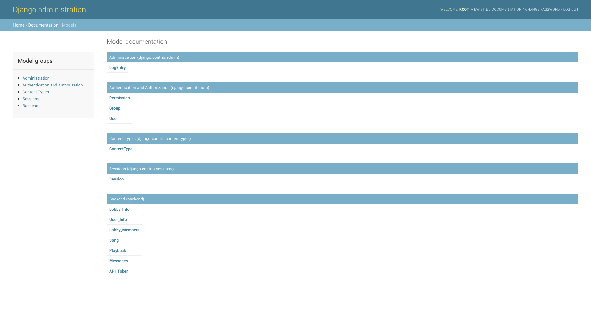

Slide 21
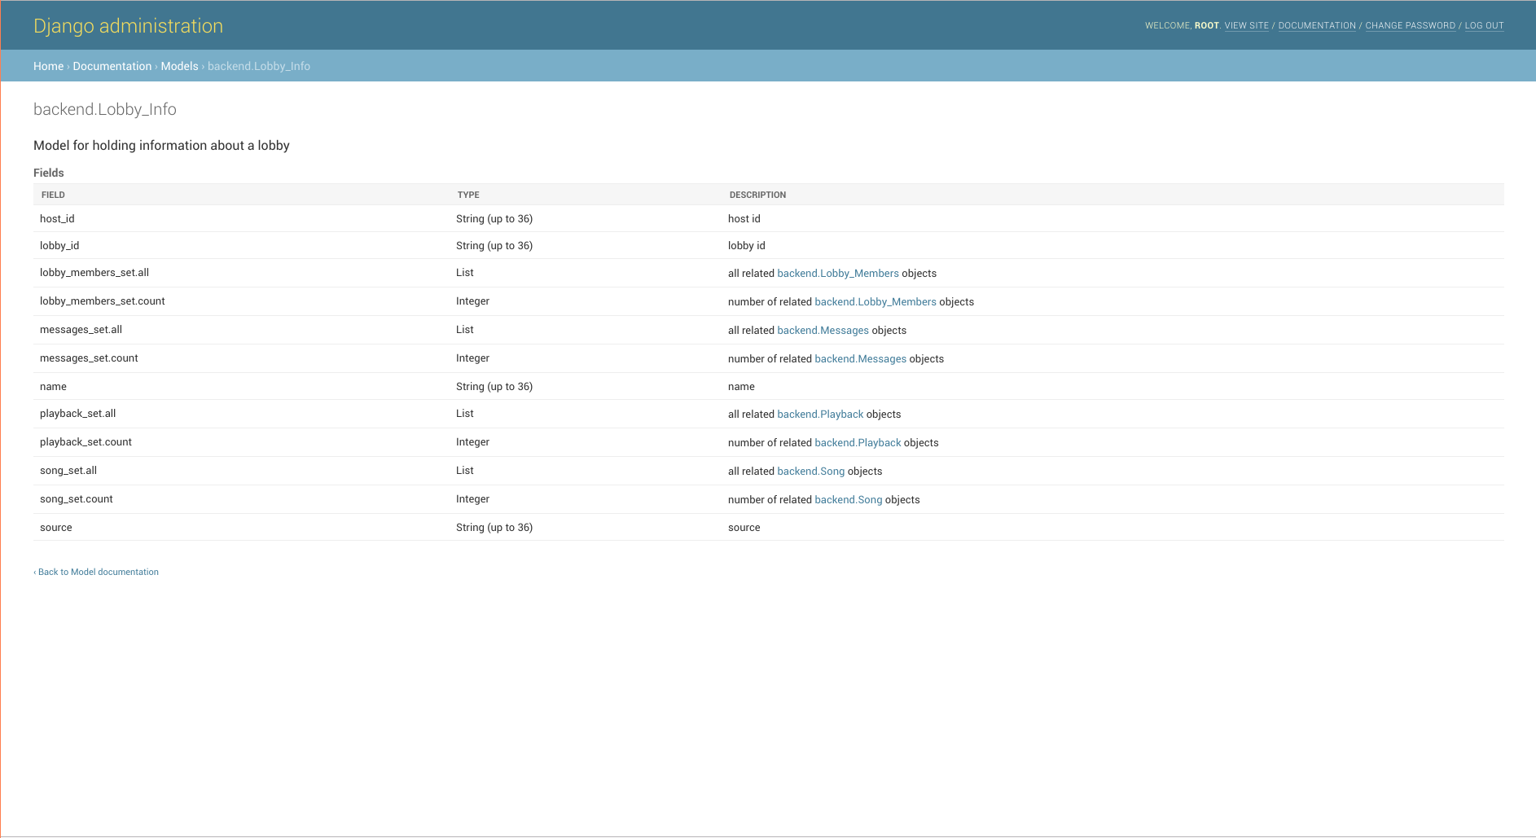

Slide 22
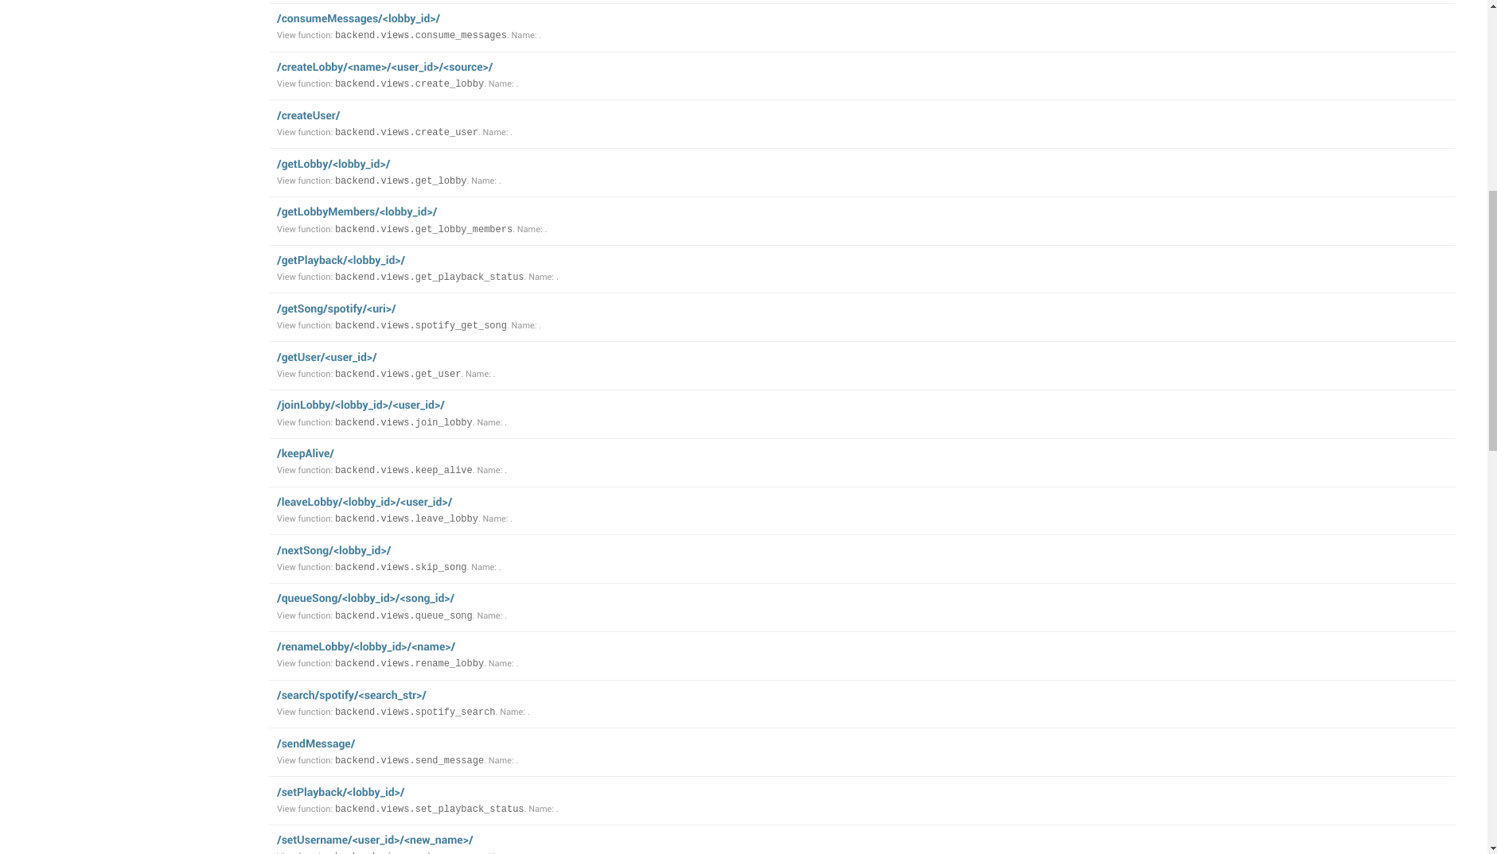

Slide 23
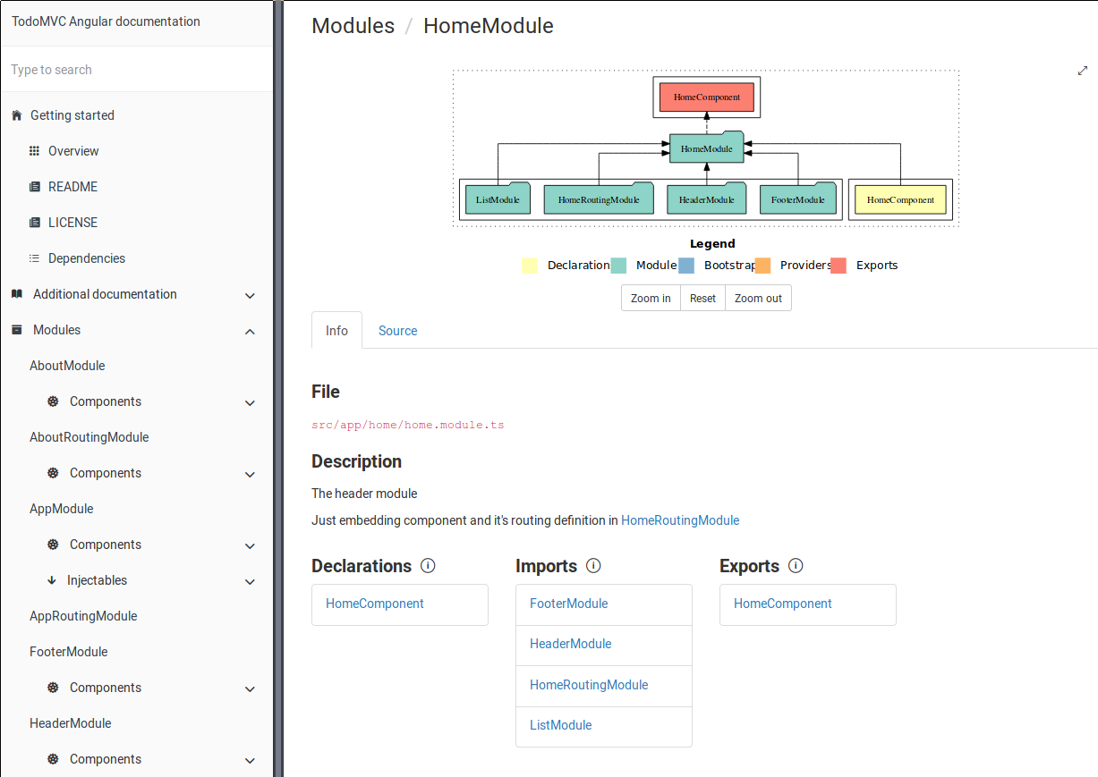
Notes:
Switch this to real screen shot

Slide 24
Individual Contributions
Notes:
owen

Slide 25
Jacob Alspaw
Site design
Flexible site layout
Developed chat room
Helped with pulling data from spotify API for music search
Connecting each module to the chat room
Many bug fixes

Slide 26
Owen Helmstetter
Angular
Designed classes / data models
User, PlaybackStatus, Song, Artist, etc..
Services: lobby, spotify, music
Most of the client-side logic and features
authentication, synchronization, modifying lobbies, etc…
Components: lobby-info
Django
Playback, queuing, and syncing functionality
Spoti-py API authentication

Slide 27
Alex Hemm
Python testing setup
Playback component organization
Set up SoundCloud API
Not supported by SoundCloud
Pulling song metadata from Spotify API
Song metadata
Playlists - Global top 50 in search results
Angular unit testing

Slide 28
Ted Timbrell
Helped with creation of database models
Bug fixed song model logic error
Create user functionality
Messing with CORS
Backend testing
Angular
Lobby members functionality
Reworked user_id functionality

Slide 29
Bobby Wagner
Setup infra tooling (docker, makefiles, etc)
Created backend documentation
Automated backend code style
Created Database Models
Helped with backend testing
Assorted Debugging

Slide 30
Summary
Notes:
owen

Slide 31
Lessons Learned
Websockets would have greatly simplified client-server interaction
Migrations and Git do not play well together
The free version of Trello was limiting

Slide 32


Future Work
Native (Mobile) support
Song voting system
Additional music sources
Switching between audio sources
Additional chat room features
Voice communications
Text chat support: Rich links, formatted text, emojis
Lobby commands
Notes:
Alex

Slide 33
Summary
Created a web app for users to share a listening experience in the browser
Implemented a real time messaging service
Let’s go listen to some music!
Notes:
Alex

Slide 34
Demo

Slide 35
Questions?

